Slide 1

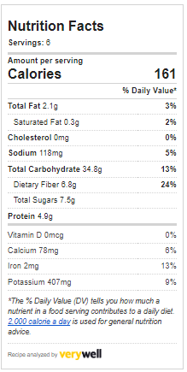
Joy of Living Cooking School
May 2023 – Taco Time
Cauliflower Al Pastor (6 Servings)
1 Head of Cauliflower
2 cups Fresh Pineapple, small dice (divided)
1 tablespoon Fresh Oregano
2 Garlic Cloves
4 Cloves
1/4 cup Paprika
Optional: 2 tablespoons Smoked Paprika
1 tablespoon Liquid Aminos
2 tablespoons Fresh Lime Juice (about 1 lime)
1/4 cup Water
12 Corn Tortillas
Fresh Cilantro, Diced Onions, Fresh Lime (for garnish)
Preheat oven to 450° F. Line a sheet pan with foil. Set aside
Trim the leaves from the cauliflower head. Remove florets and cut into bite-sized pieces. Transfer to a large mixing bowl.
To the pitcher of a blender add one cup of pineapple, oregano, garlic, cloves, paprika, smoked paprika, liquid aminos, lime juice, and water. Blend on high for 30 seconds until it turns into a thick smooth paste. Pour the paste over the cauliflower pieces and mix until thoroughly combined and all the cauliflower is evenly coated. Spread the cauliflower into an even layer on the foil-lined pan, taking care to evenly spread the pieces in an even single layer. Sprinkle the remaining one cup of pineapple pieces over the cauliflower.
Bake the cauliflower for 20-25 minutes until the cauliflower is softened. Turn on the broiler and continue to cook until the cauliflower and pineapple are slightly charred (about 5 minutes). Remove from oven and allow to rest for 5 minutes.
Heat tortillas until softened. Fill each tortilla with the cauliflower/pineapple al pastor. Garnish with chopped cilantro and onion. Place a lime wedge on the side.
Serves two tacos per person.

Slide 2
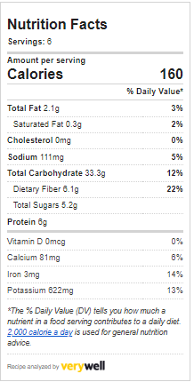
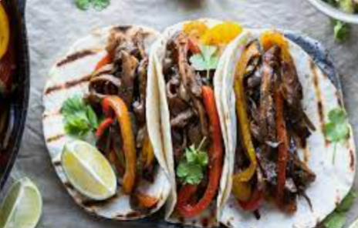
Joy of Living Cooking School
May 2023 – Taco Time
Mushroom Fajitas (6 Servings)
4 Portobella Mushrooms
1/2 teaspoon Garlic Powder
1/2 teaspoon Onion Powder
1 tablespoon Cumin (ground)
1 tablespoon Paprika
1 tablespoon Fresh Oregano, chopped
2 Garlic Cloves, minced
1 tablespoon Liquid Aminos
2 tablespoons Fresh Lime Juice (about 1 lime)
2 tablespoons Water
1 large White Onion, sliced
2 Bell Peppers (red, yellow, or orange), sliced
12 Corn Tortillas
Preheat oven to 450° F. Line a sheet pan with foil. Set aside
Clean the mushrooms by wiping away any visible dirt. Remove the stem. Use a small spoon to remove the brown gills. Discard the gills. Slice the mushroom caps and stems into strips approximately 1/3 of an inch thick. Place into a large mixing bowl and set aside.
In a small bowl combine the garlic powder, onion powder, cumin, paprika, oregano, minced garlic, liquid aminos, lime juice, and water. Whisk until thoroughly mixed. Pour the marinade over the mushroom pieces and mix until the mushrooms are evenly coated. Allow to marinate for at least 15 minutes up to 1 hour.
Transfer the mushroom slices to the foil pan. Arrange the mushrooms in a single layer that covers about 1/4 of the pan. Add the onions next to the mushrooms. Next the peppers.
Bake the vegetables for 20-25 minutes until everything is softened and the mushrooms has shrunk slightly. Turn on the broiler and continue to cook until the vegetables are slightly charred (about 5 minutes). Remove from oven and allow to rest for 5 minutes.
Heat tortillas until softened. Serve on baking tray with serving tongs. Allow guests to build their own fajita tacos mixing ingredients as they like. Serve with favorite taco toppings.
Serves two tacos per person.

