Slide 1
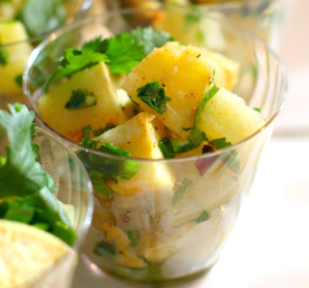
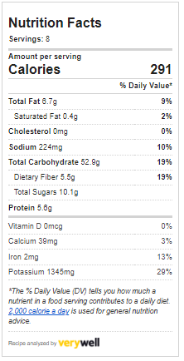
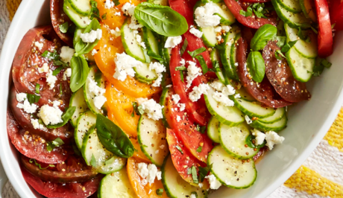
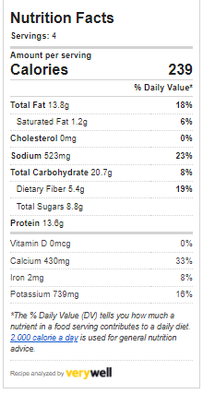
Joy of Living Cooking School
September 2022 – Cool Salads
Peruvian Princess Pineapple Potato Salad
6 large red potatoes
½ tsp. salt
½ tsp. white pepper
1 tsp dried basil
1 red onion, finely chopped
1 can pineapple
1/3 cup Veganaise
1 tsp turmeric
Boil potatoes whole until tender enough to poke through with a fork, yet
still firm, about 20 minutes.
Dice potatoes into bite size pieces and add seasoning and herbs first. Add onion
And pineapple and gently fold into potatoes.
Add Veganaise and turmeric and gently mix into potato mixture while still warm.
Chill and serve cold.
Tomato Salad with Lemon-Basil Vinaigrette (8 servings)
Seek out several varieties of heirloom tomatoes for this simple salad. Sweeter and juicier than conventional tomatoes, they add the perfect pop of color.
¼ cup chopped fresh basil, plus more for garnish
3 tablespoons lemon juice
2 tablespoons olive oil
2 teaspoons Turmeric
¼ teaspoon salt
⅛ teaspoon white pepper
4 large firm multicolor heirloom tomatoes, sliced
2 medium English cucumbers, thinly sliced
1 red onion, thinly sliced and quartered
⅔ cup crumbled soy feta cheese
Whisk basil, lemon juice, oil, mustard, salt and pepper in a large bowl.
Arrange tomatoes and cucumbers in a serving dish. Drizzle with dressing,
sprinkle with feta and top with basil, if desired.
Serving Size: 1 1/4 cups

