Slide 1
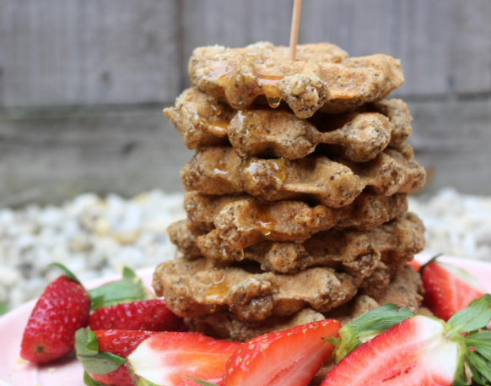
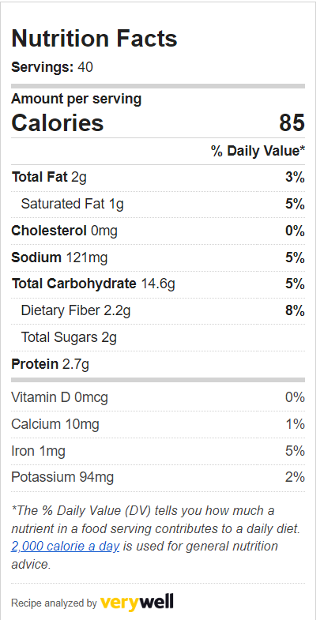
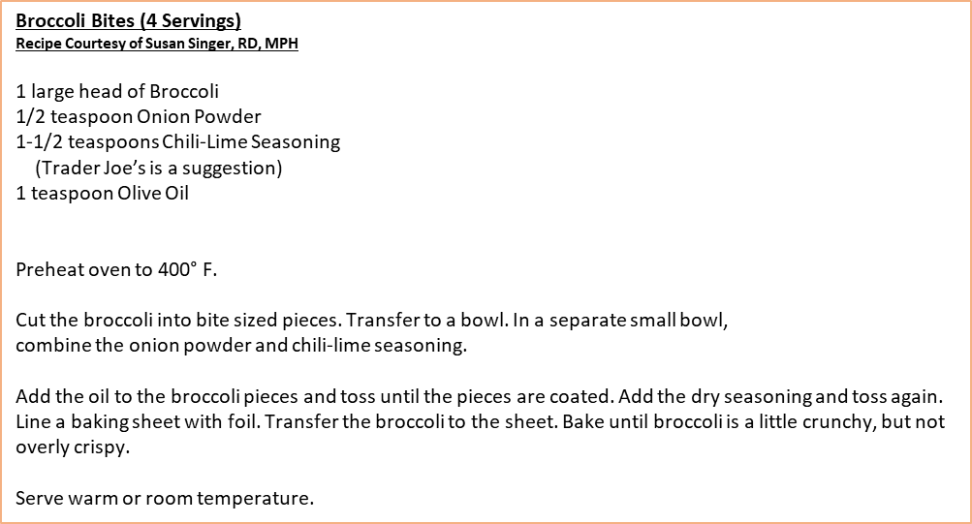
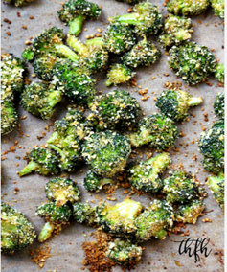
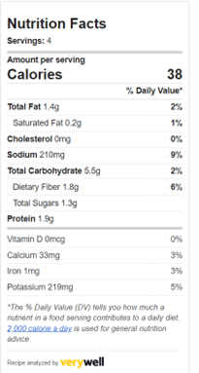
Joy of Living Cooking School
January 2023 – Cancer Fighters
Healthy Waffles (approx. 40 waffles)
Recipe Courtesy of Susan Singer, RD, MPH
7 cups Quick Oats
1 cup Cornmeal
2 teaspoons Salt
1/4 cup Nutritional Yeast
1/2 cup Ground Unsweetened Coconut
(optional)
7 cups Water
1/4 cup Honey
1-2 cups Additional Water
The night before combine the dry ingredients in a large bowl. Stir to mix
thoroughly. Add the 7 cups of water, honey, and vanilla to the bowl and mix until
There are no dry ingredients. Refrigerate for 6-8 hours.
When ready to cook, add the additional water until the batter reaches the desired consistency. The batter will be much thicker than a traditional batter. Preheat a waffle maker according to directions. When the waffle iron is ready, pour a 1/4 cup of batter in each well. Bake for approximately 9 minutes, until browned and cooked through.
Can be served immediately or refrigerate/freeze and reheat with a toaster.
Suggested toppings: almond butter, fresh fruit, applesauce with flaxseed.
Notes: The batter can be adjusted to taste. Some prefer blending the mix until smooth. Be aware of the amount of honey as too little honey will prevent browning and too much honey will increase the chance of burning.

Slide 2

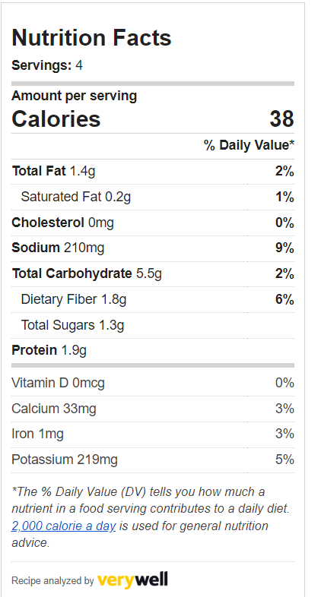
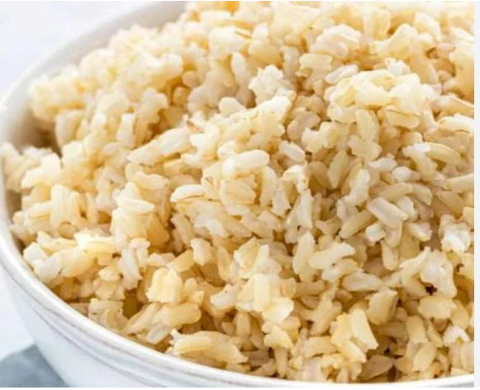
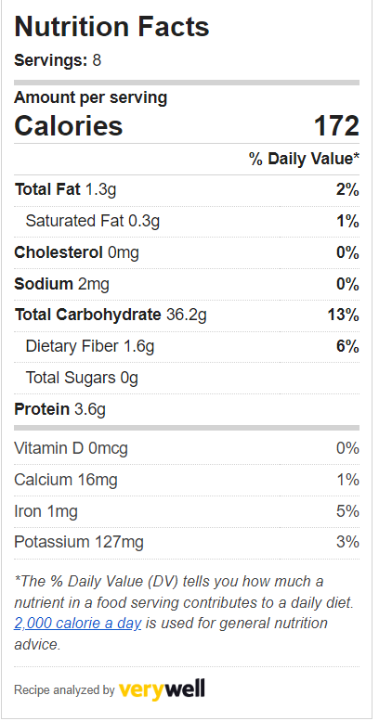
Joy of Living Cooking School
January 2023 – Cancer Fighters
Sweet Potato Curry (8 Servings)
Recipe Courtesy of healthourtreasure.com
4 medium Sweet Potatoes (peeled in 1” cubes)
1 onion (small dice)
4-5 Tomatoes (large dice)
3 cloves Garlic (crushed)
1 teaspoon Salt
1 teaspoon Ground Cumin
1/2 teaspoon Curry Powder
1/2 teaspoon Paprika
1 bag Frozen Chopped Spinach (12-16 oz)
1 can Lite Coconut Milk
1 can Garbanzo Beans (drained)
Juice from 1 Lime
Preheat oven to 400° F. Line a baking sheet with foil. Spread the sweet potatoes
Out evenly on the baking sheet. Cook for 20-30 minutes until softened.
Preheat a large skillet over medium high heat. Add the onions and cook until softened, about 5 minutes, adding small amounts of water as needed to prevent sticking. Add the tomatoes and cook another 5 minutes. Add the garlic, salt, cumin. curry powder, and paprika. Simmer for 3 minutes. Add the spinach, coconut milk, garbanzo beans and simmer for 3 minutes. Add the cooked sweet potatoes and stir well. Simmer a final 5 minutes. Add the lime juice.
Serve warm.
Baked Brown Rice (8 Servings)
Recipe Courtesy of healthourtreasure.com
2 cups Brown Rice
4 cups Water
Preheat oven to 350° F.
Add the rice to a large mixing bowl and fill with water.
Using your hands, scrub the rice until the water is cloudy. Strain
off the water and repeat. Continue to wash and rinse until the
water is clear.
Transfer rice to am oven-proof casserole dish. Add the 4 cups of water. Bake for 1 hour. Fluff with a fork when rice is softened.
Serve warm.

